Slide 1

GAP ANALYSIS
BRIGHTLEARN ONLINE EDUCATION PLATFORM
UGOCHI EKOH

Slide 2

Content
Project Overview
Challenges Faced
Goals
Analysis Tools
Swot Analysis
Pestel Analysis
Fishbone Diagram
Mckinsey Framework
Recommendation
Conclusion
BRIGHTLEARN ONLINE EDUCATION

Slide 3

Project Overview
This report presents a comprehensive gap analysis for BrightLearn, an online education platform catering to high school and college students. Despite steady growth, increasing competition and technological advancements from competitors necessitate a thorough analysis to identify operational gaps, opportunities, and strategies for enhancing competitiveness in the online education sector. This analysis uses four strategic tools which are SWOT Analysis, PESTLE Analysis, Fishbone Diagram, and McKinsey 7S Framework.
BRIGHTLEARN ONLINE EDUCATION

Slide 4
CHALLENGES FACED BY BRIGHTLEARN
Increasing number of competitors adopting new technologies and features.
Outdated Technology: The platform may not be utilizing the latest educational technologies.
Ineffective Marketing: Low visibility and poor marketing strategies that fail to attract new students.
Low Retention Rates: Difficulty in maintaining student interest and engagement, leading to high dropout rates.
Regulatory Uncertainties: Potential changes in education policies that could impact operations and compliance.

Slide 5
GOALS
Identify Operational Gaps: Understand areas where BrightLearn is lacking compared to competitors.
Explore Opportunities: Identify new technologies and market trends that can be leveraged for growth.
Enhance Engagement and Retention: Develop strategies to improve student engagement and reduce dropout rates.
Strengthen Competitive Position: Put together actionable strategies to differentiate BrightLearn from competitors.
Create a Strategic Roadmap: Outline a clear plan for implementing changes and tracking progress toward goals.
Ensure Compliance: Address potential regulatory challenges.

Slide 6

ANALYSIS TOOLS
Swot, Pestle, Fishbone $ Mckinsey 7s framework

Slide 7
Project analysis slide 8
SWOT ANALYSIS
Strengths | Weaknesses | Opportunities | Threats
Recognized in the online education space | Outdated platform interface and Limited interactive learning tools | Growing demand for online learning | Aggressive competition (Coursera, Udemy, etc.)
Experienced educators | Ineffective marketing strategies | Expansion into new markets (test prep, certifications) | Rapid tech advancements (AI, VR, gamification)
Affordable pricing | Low student retention |  | Price wars from competitors
Offer Wide range of subjects/ courses for high school and college students. | Limited Interactive learning tools (e.g, Live sessions, interactive quizzes) | Partnerships with schools/colleges | Changes in educational policies affecting online learning
Ability to learn at one's own pace, accommodating diverse schedules. | Weak connections with former students, limiting networking and mentorship opportunities | AI-driven personalized learning | Student preference for interactive platforms

Slide 8
Project analysis slide 8
PESTLE ANALYSIS
Political | Economic | Social | Technological | Legal | Environmental
Changes in education policies affecting online courses. | Increasing investment in online education sectors (Ed-tech funding is rising) | Growing acceptance of online education among students and parents. | New platforms and tools enhancing learning experiences (i.e, Advancements in Educational Technology) | Ensuring compliance with copyright laws. | Growing importance of environmentally friendly operations and policies (Sustainability Practices)
Government grants for tech-enhanced education. | Competitors offering lower-priced alternatives. | Need for tailored courses for various learning style | Increasing threats to user data security | Adhering to data protection laws e.g, GDPR) | Shift to remote learning post-pandemic

Slide 9
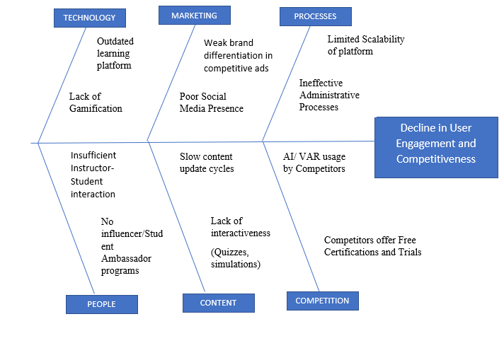
FISH-BONE DIAGRAM

Slide 10
Project analysis slide 8
MCKINSEY 7S FRAMEWORK
Element | Current State | Recommended Changes
Strategy | May not be focused on innovation | Develop a strategy focused on innovation and competitive differentiation.
Structure | May not be agile | Adopt a more agile organizational structure.
Systems | May be outdated | Modernize technology systems.
Shared Values | May not prioritize innovation | Foster a culture that values innovation and customer satisfaction.
Skills | Potential skill gaps in new technologies | Invest in training to address skill gaps.
Style | Leadership style may hinder change | Promote a leadership style that is conducive to change.
Staff | Staffing may not align with strategic goals. | Align staffing levels and skills with strategic goals.

Slide 11
Project analysis slide 3
RECOMMENDATION
PHASE TWO
•Conduct user surveys to gather insights on needed improvements and preferences.
•Update marketing strategies to increase visibility.
•Begin research on advanced LMS options/ Implement new technology tools for efficiency.
•Implement new technologies and features for interactive learning.
•Form partnerships with educational institutions.
•Launch targeted marketing campaigns.
•Improve customer training programs.
•Continuously assess and adapt to technological advancements.
•Expand course offerings based on user feedback.
•Maintain a strong focus on user data security and compliance.
PHASE ONE
PHASE THREE

Slide 12
CONCLUSION
BrightLearn is an online education platform catering to high school and college students, though it currently faces operational and strategic gaps, it also possesses solid foundational assets such as Recognition in the Online Education Space, Experienced Educators and Affordable pricing. By addressing these gaps through innovation, agility, and a learner-centered approach, it can regain competitiveness and position itself for significant growth in the future. BrightLearn’ s main gaps lie in technology, Marketing, Processes, People, Content and Competition.
By implementing AI, gamification, and modern UX, the platform can regain competitiveness. A recommended phased roadmap ensures sustainable growth while adapting to industry trends. BrightLearn has opportunities to enhance its competitive position in the online education market by addressing its weaknesses and leveraging its strengths. By implementing the suggested strategies and focusing on technological advancement, marketing, and user engagement, BrightLearn can significantly improve its enrollment and retention rates.

Slide 13





Thank You
Ugochi Ekoh
+234 7045285216
ugochiekoh@gmail.com
Business Analyst

